Slide 1
Tagged Release Version
Meeting November 5, 2024

Slide 2
Completed since last meeting
Added Tecplot post-processing examples to the manual:
Slices e.g. GWF saturations
Calculating new values in Tecplot e.g. pressure head=z-elevation
Isosurfaces (e.g. water table)
Value blanking
SWF to GWF Infiltration plot

Slide 3
What do we need to do?
I need to read once more through the manual In progress
Someone else should do a hands-on run-through of the manual and verification examples
The verification examples chapter needs to be finalized
Index entries could be improved
Update the repositories and create a tagged release e.g. Version 2024.month (tagged bug fixes and updates would be 2024.1, 2024.3…..)
RCH is the only boundary condition that is currently set up to change over multiple stress periods
RCH currently applied to entire top layer of GWF and all of SWF by default
WEL function with CLN cells only works with my modified usgs_1.exe.
Is Abdul our Illustrative example. Currently that chapter of the manual is a placeholder only.

Slide 4
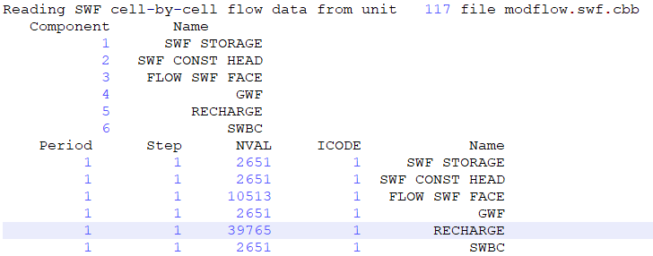
Known issues
No velocity vectors
SWF Recharge is writing nCells GWF number of values to cbb file and they are all zero. This is from abdul _posto.eco file:
This could be related to not setting up the icbb files for GWF and SW correctly when usgs_1 is writing cell-by-cell flows

Slide 5
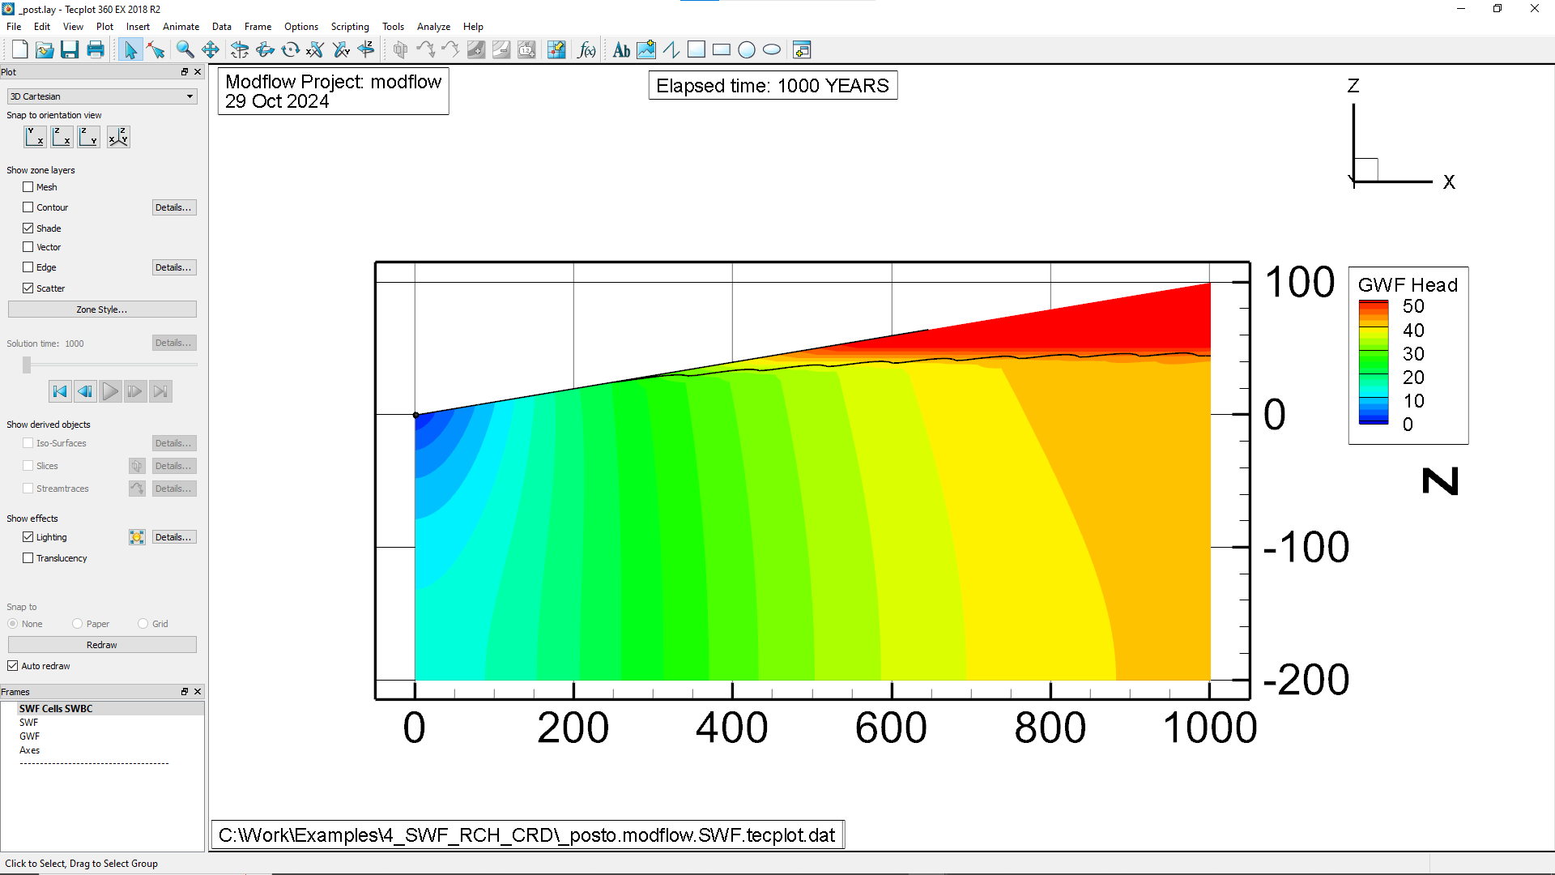
Verification example: 4_SWF_RCH_CRD
Humps in water table
Non-zero surface water depth extends upslope now
Wrong alpha value

Slide 6
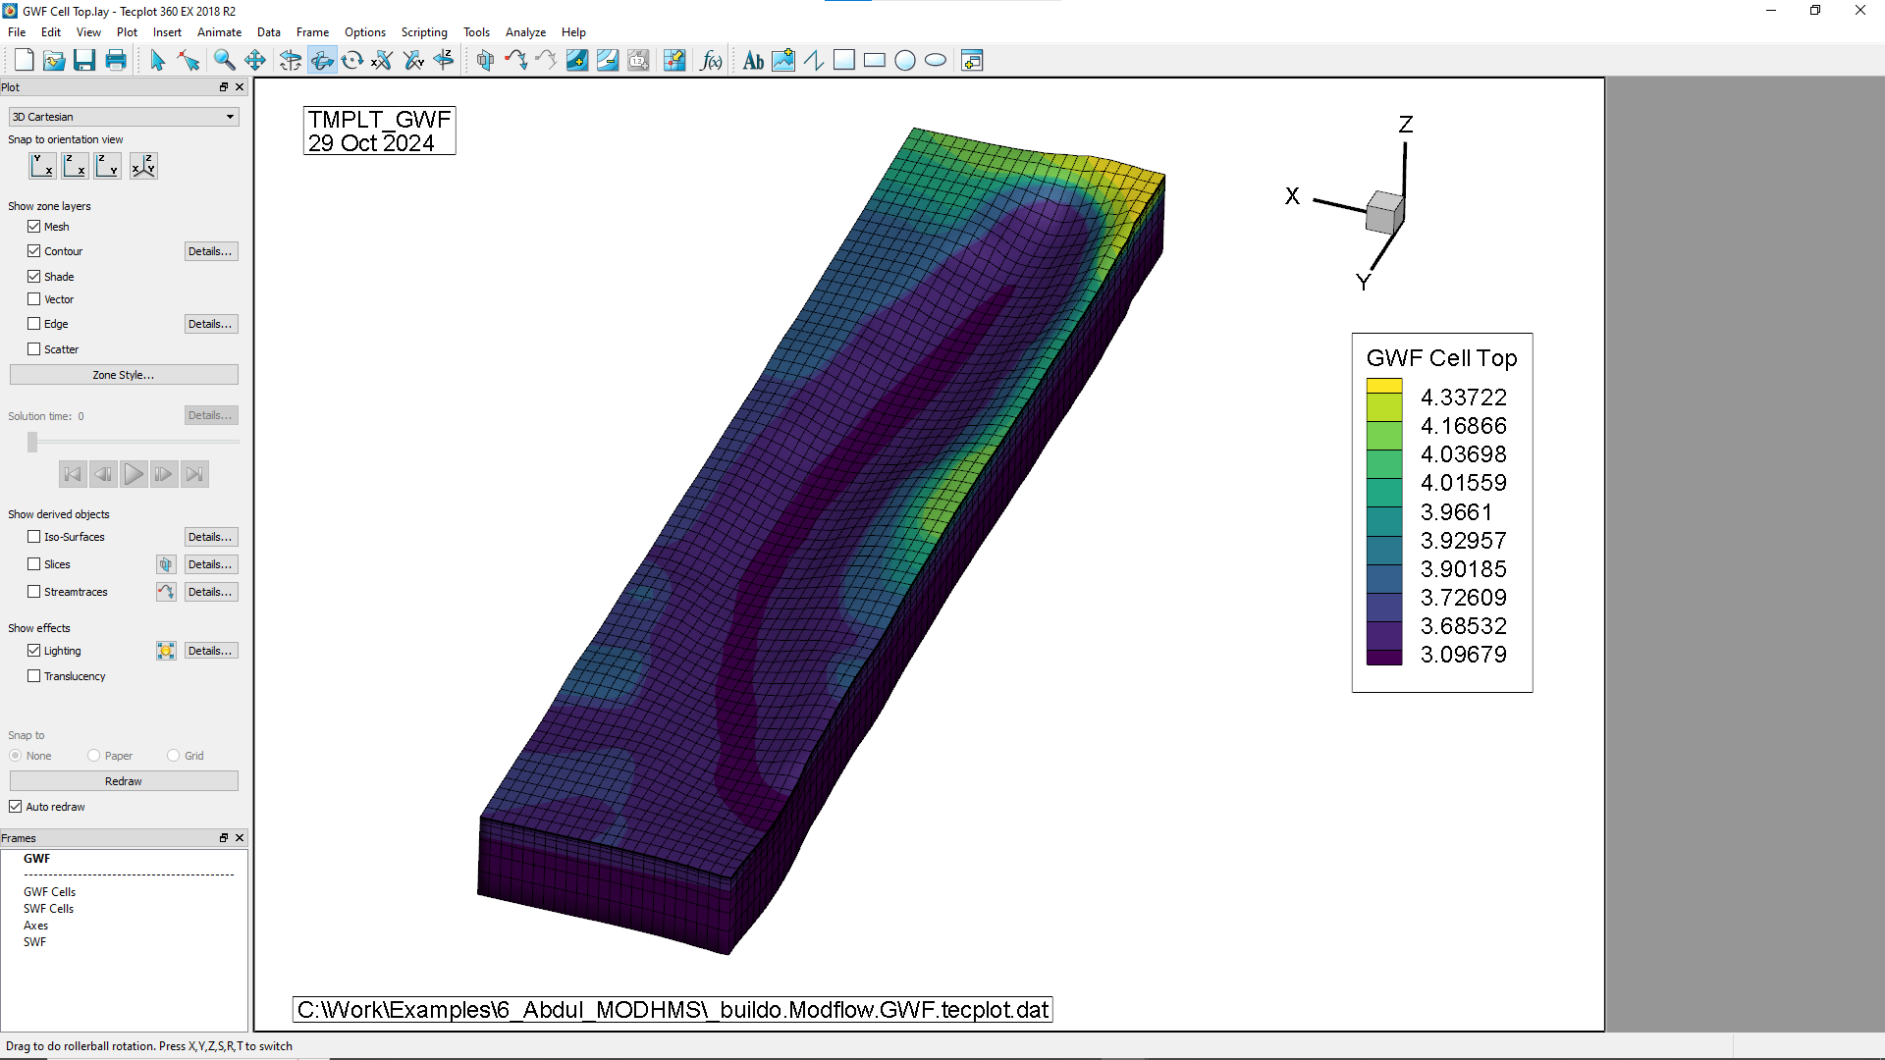
Verification example: 6_Abdul_MODHMS
X-axis reversed compared to Abdul
?

Slide 7
There is currently no tutorial for Github Useage in Visual Studio

